Slide 1
Mastering Blockchain Third Edition
Chapter 6, Introducing Bitcoin

Slide 2
Outline
Bitcoin—an overview
Cryptographic keys
Transactions
Blockchain
Mining

Slide 3
Bitcoin—a user's perspective
How to send and receive payments
Steps:
The transaction starts with a sender signing the transaction with their private key.
The transaction is serialized so that it can be transmitted over the network.
The transaction is broadcast to the network.
Miners listening for transactions pick up the transaction.
The transaction is verified for its legitimacy by the miners.
The transaction is added to the candidate/proposed block for mining.
Once mined, the result is broadcast to all nodes on the Bitcoin network.
Usually, at this point, users wait for up to six confirmations to be received before a transaction is considered final; however, a transaction can be considered final at the previous step. Confirmations serve as an additional mechanism to ensure that there is probabilistically a very low chance for a transaction to be reverted, but otherwise, once a mined block is finalized and announced, the transactions within that block are final at that point.

Slide 4
Cryptographic keys
Private keys in Bitcoin
Private keys are used to digitally sign the transactions, proving ownership of the bitcoins.
Public keys in Bitcoin
Public keys are used by nodes to verify that the transaction has indeed been signed with the corresponding private key.
Addresses in Bitcoin
A Bitcoin address is created by taking the corresponding public key of a private key and hashing it twice, first with the SHA256 algorithm and then with RIPEMD160.
Bitcoin addresses are encoded using Base58Check encoding
QR code of the Bitcoin address 1ANAguGG8bikEv2fYsTBnRUmx7QUcK58wt
From bitaddress.org,
a private key and Bitcoin address
in a paper wallet

Slide 5
Address generation in Bitcoin
To generate an address in Bitcoin, an 11 step process is used, as depicted here:

Slide 6
Transactions
A user/sender sends a transaction using wallet software or some other interface.
The transaction is signed using the sender's private key.
The transaction is broadcasted to the Bitcoin network using a flooding algorithm.
Mining nodes (miners) who are listening for the transactions verify and include this transaction in the next block to be mined.
Next, the mining starts.
Finally, the confirmations start to appear in the receiver's wallet.

Slide 7
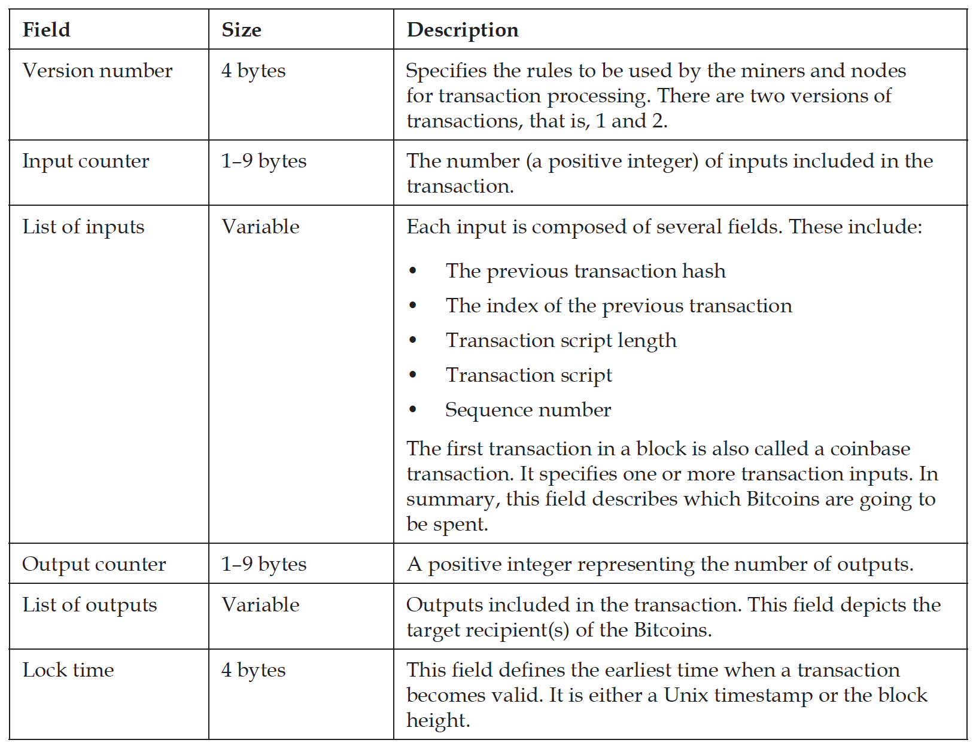
The transaction data structure

Slide 8
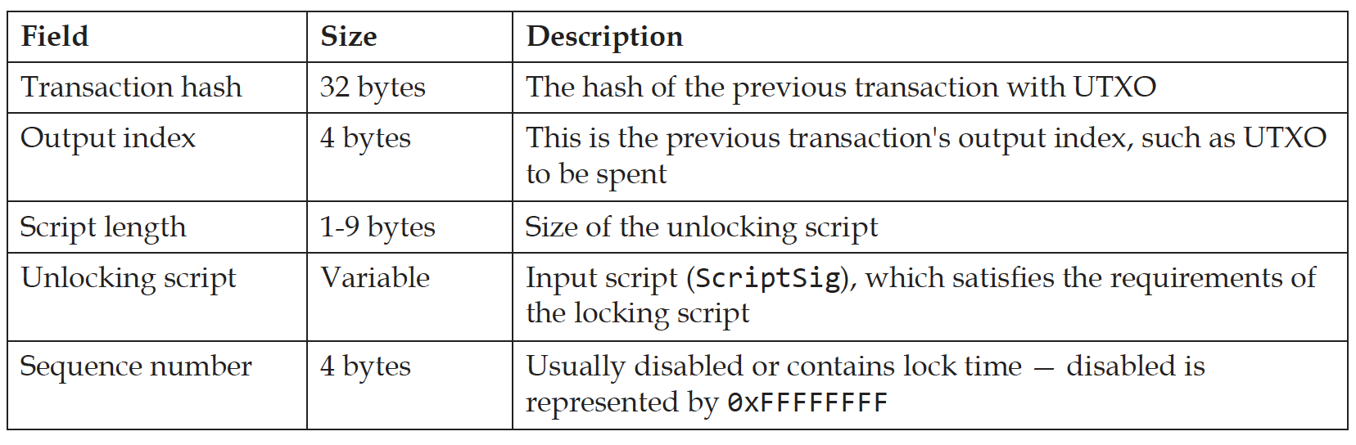
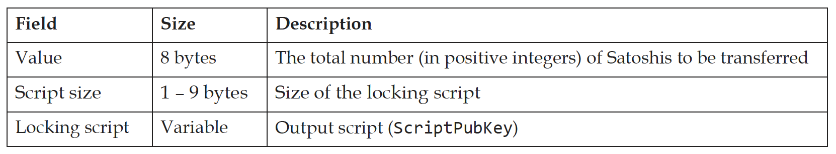
The transaction data structure – inputs and outputs
Transaction input data structure
Transaction output data structure

Slide 9
Script
Simple stack-based language used to describe how bitcoins can be spent and transferred
Evaluated from left to right using a Last in, First Out (LIFO) stack
Composed of two components: elements and operations.
Scripts use various operations (opcodes) to define their operations.

Slide 10
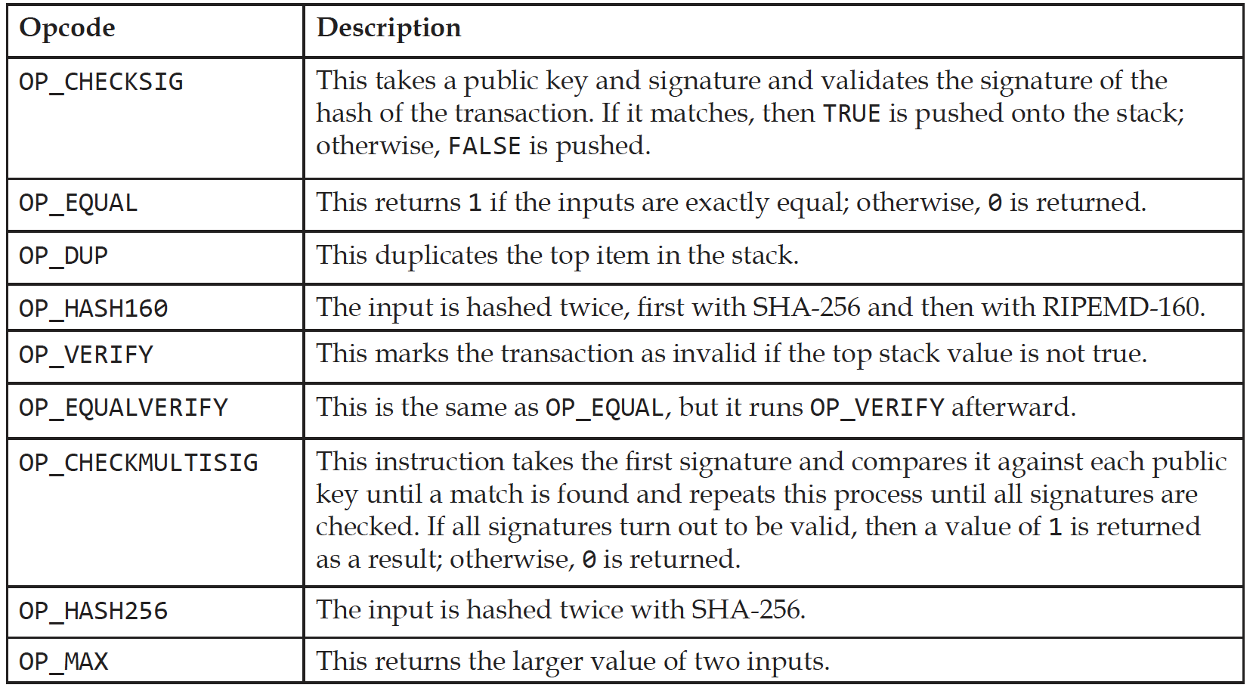
Opcodes
Here are some examples of a few useful opcodes used in the Script language on the Bitcoin blockchain.

Slide 11
P2PKH script execution
P2PKH is the most commonly used transaction type and is used to send transactions to Bitcoin addresses.

Slide 12
Transaction validation
During validation, the following are checked:
That transaction inputs are previously unspent. This validation step prevents double-spending by verifying that the transaction inputs have not already been spent by someone else.
That the sum of the transaction outputs is not more than the total sum of the transaction inputs. However, both input and output sums can be the same, or the sum of the input (total value) could be more than the total value of the outputs. This check ensures that no new bitcoins are created out of thin air.
That that the digital signatures are valid, which ensures that the script is valid.

Slide 13
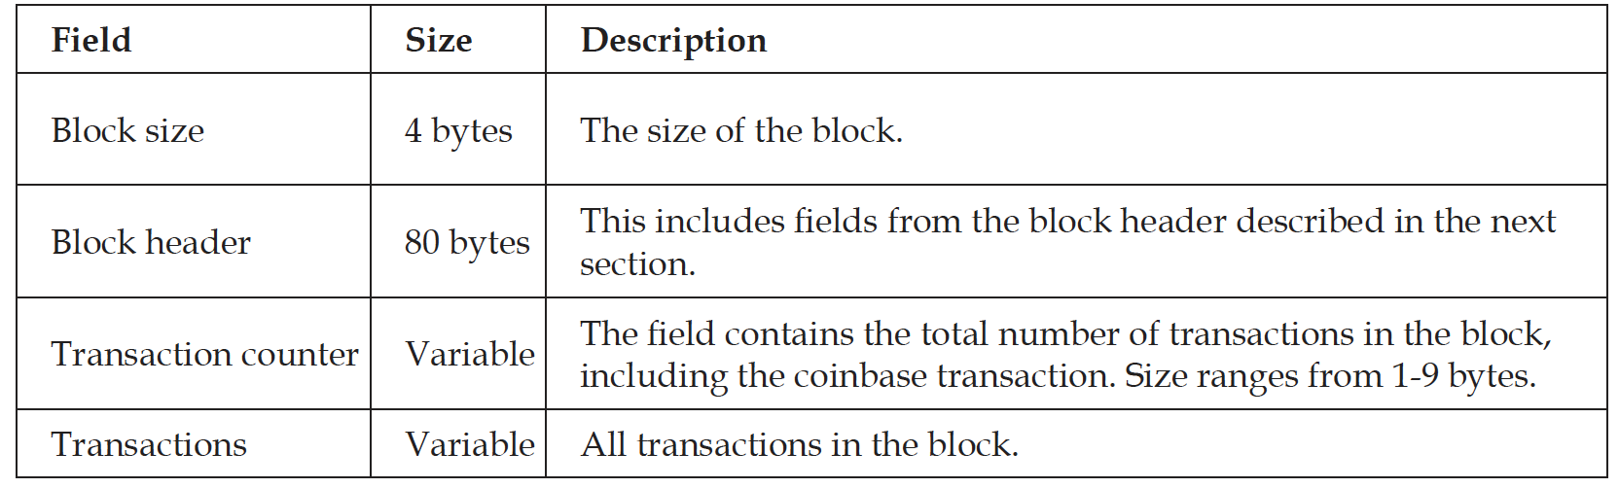
Blocks
The data structure of a Bitcoin block is shown in the following table:

Slide 14
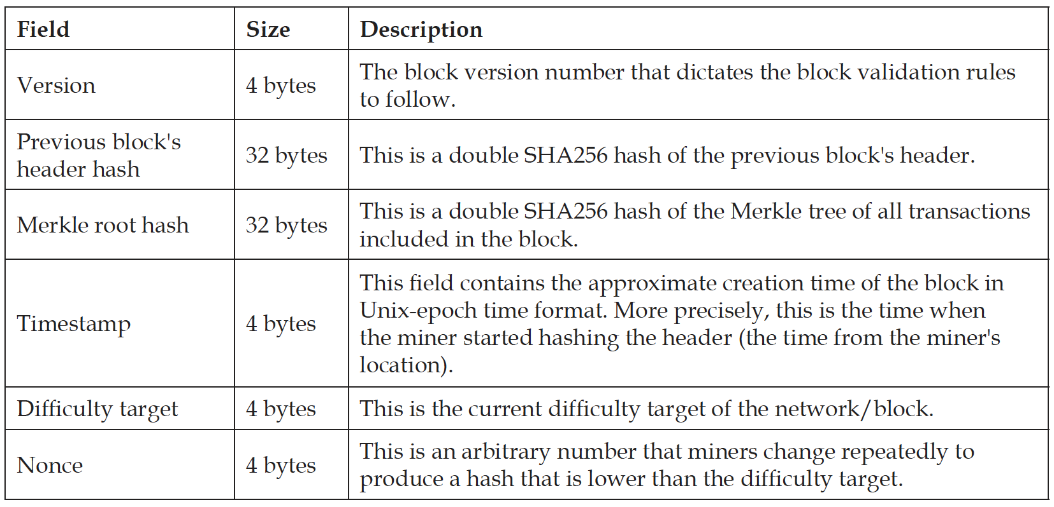
Blocks
The structure of a block header is shown here:

Slide 15
A visualization of the Bitcoin blockchain

Slide 16
Stale and orphan blocks
Stale blocks exists on a shorter chain, from which the main chain has progressed
Orphan block’s parent blocks are unknown

Slide 17
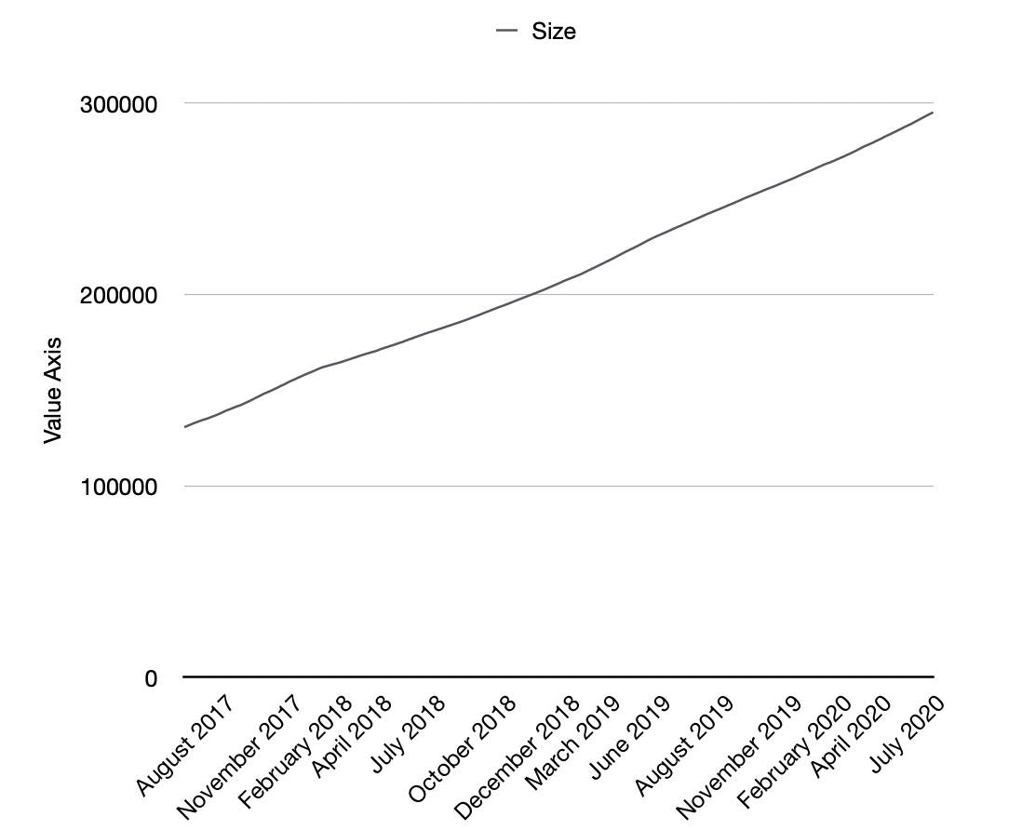
Blockchain size
Bitcoin blockchain size in gigabytes—Aug 2017 to Jul 2020. It is currently approximately 286GB

Slide 18
Mining
Synchronizing with the network
Transaction validation
Block validation
Create a new block
Perform PoW
Fetch reward

Slide 19
Mining systems
Four types of mining hardware. From left to right: a CPU, GPU, FPGA, and an ASIC

Slide 20
Exercise
Install a Bitcoin client, and run experiments on it!

Slide 21
Summary
In this presentation, we covered:
An introduction to Bitcoin
How transactions work
Public and private keys in Bitcoin
Addresses and their different types
Transactions and their types and usage
Blockchain and the various components included in the Bitcoin blockchain

